Slide 1

Unit 7 Sequential Circuits (Flip Flop, Registers)
College of Computer and Information Sciences
Department of Computer Science
CSC 220: Computer Organization

Slide 2
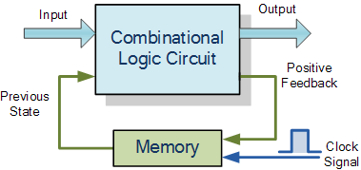
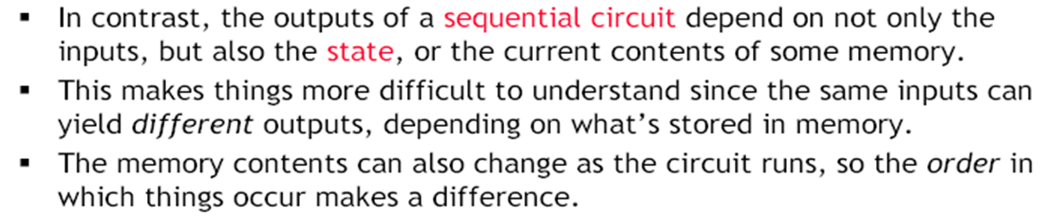

Slide 3
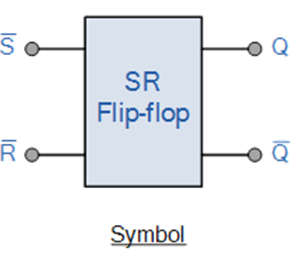
SR Flip-Flop
The SR flip-flop, also known as a SR Latch, can be considered as one of the most basic sequential logic circuit possible.
This simple flip-flop is basically a one-bit memory bistable device
It has two inputs,
one which will “SET” the device (meaning the output = “1”), and is labelled S and another which will “RESET” the device (meaning the output = “0”), labelled R.

Slide 4
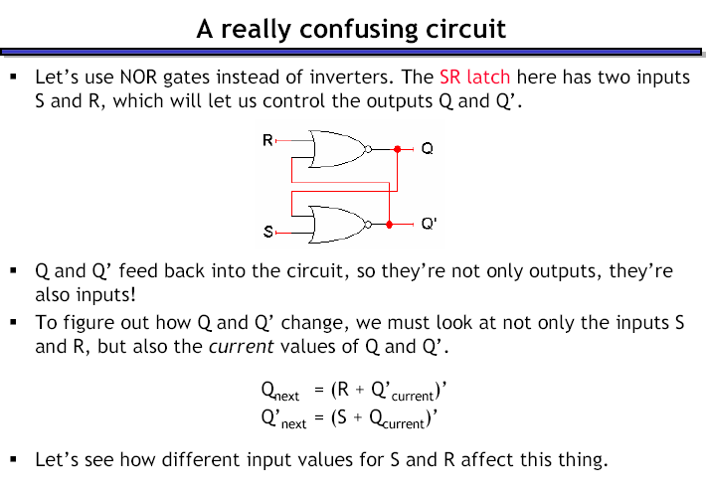

Slide 5
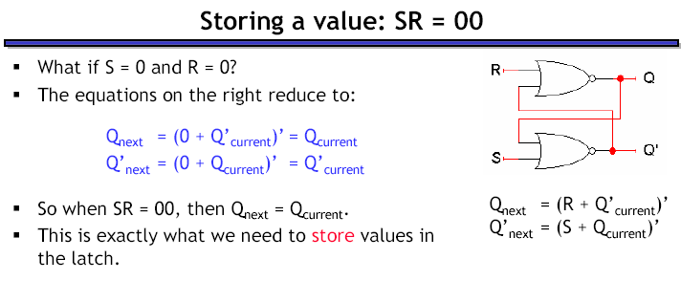

Slide 6
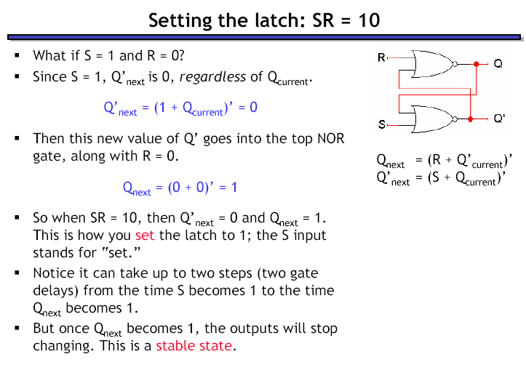

Slide 7
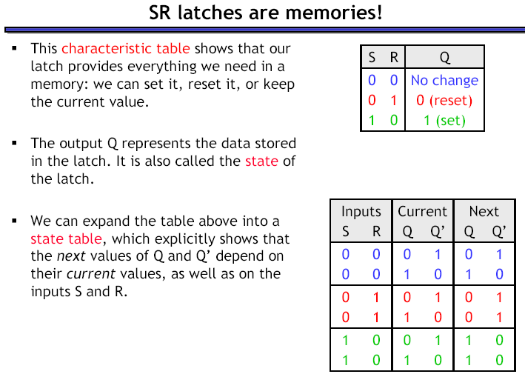
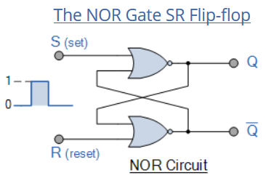

Slide 8
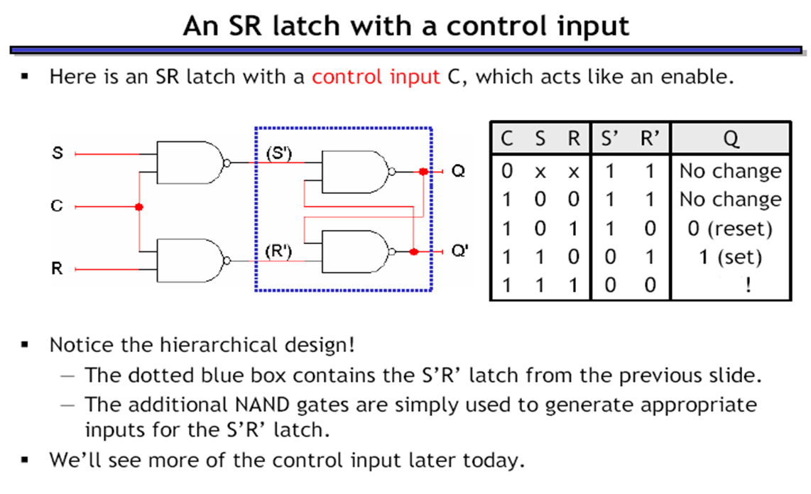

Slide 9
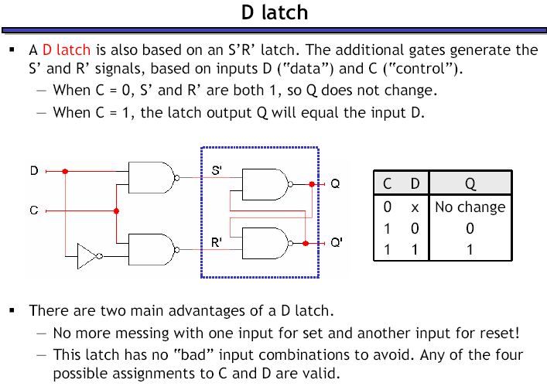

Slide 10
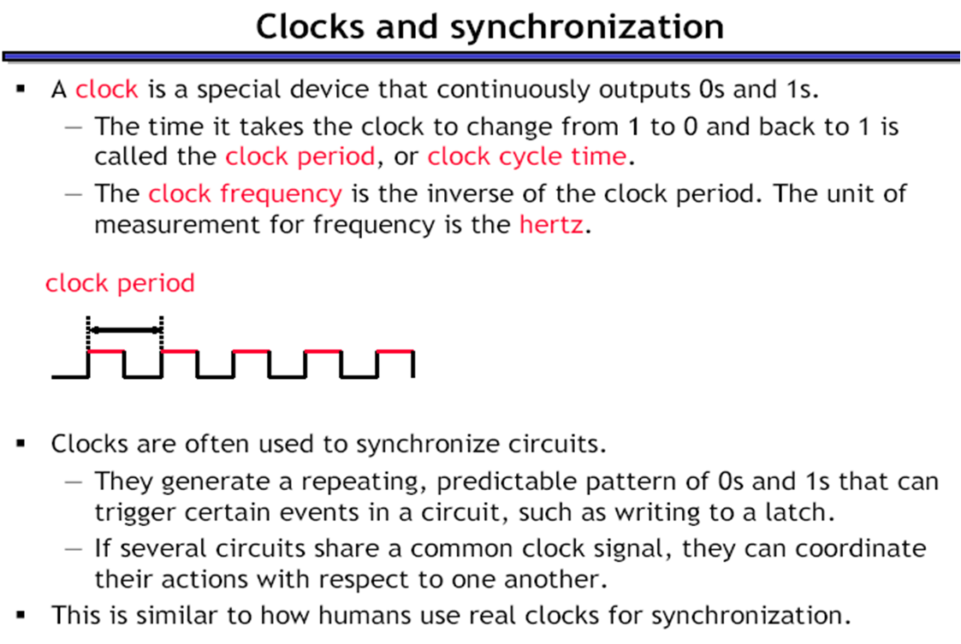
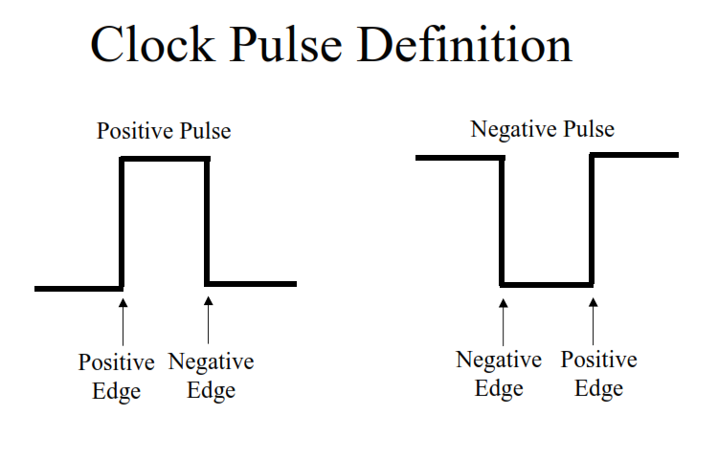
Give Examples

Slide 11
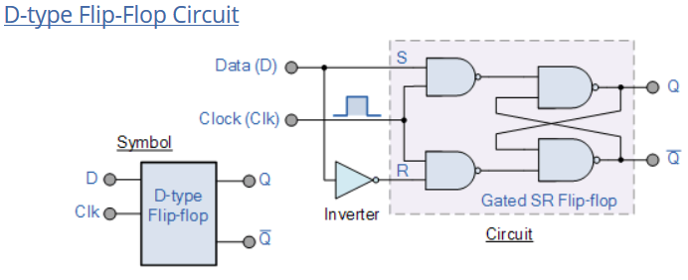
The output of the flip flop would always change on every pulse applied to this data input.
To avoid this an additional input called the “CLOCK” or “ENABLE” input is used to isolate the data input from the flip flop’s latching circuitry after the desired data has been stored. The effect is that D input condition is only copied to the output Q when the clock input is active. This then forms the basis of another sequential device called a D Flip Flop.

Slide 12
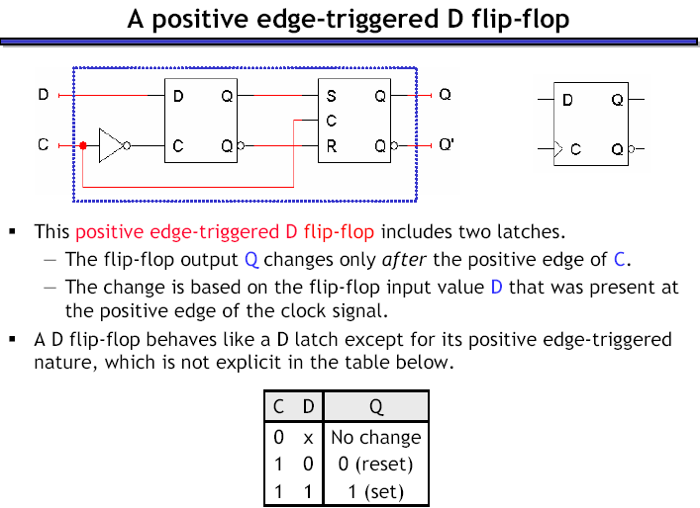

Slide 13
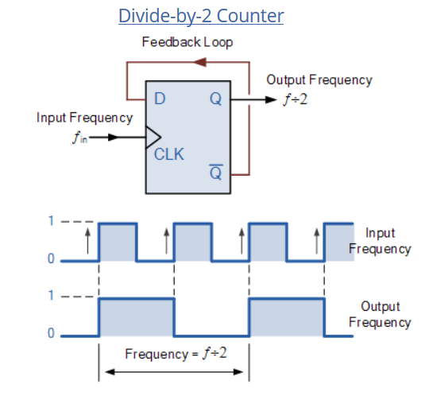
It can be seen from the frequency waveforms above, that by “feeding back” the output from Q to the input terminal D, the output pulses at Q have a frequency that are exactly one half ( ƒ/2 ) that of the input clock frequency, ( ƒ_{IN} ). In other words the circuit produces frequency division as it now divides the input frequency by a factor of two (an octave) as Q = 1 once every two clock cycles.

Slide 14
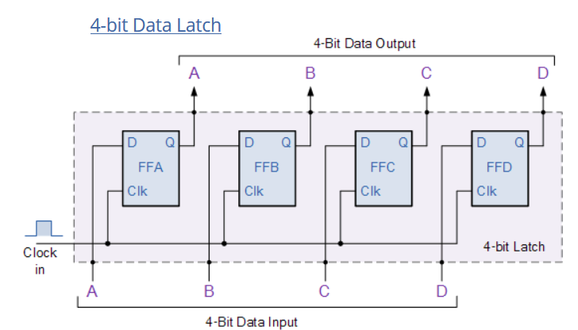
D Flip Flops as Data Latches
A data latch can be used as a device to hold or remember the data present on its data input, thereby acting a bit like a single bit memory device and IC’s such as the TTL 74LS74 or the CMOS 4042 are available in Quad format exactly for this purpose. By connecting together four, 1-bit data latches so that all their clock inputs are connected together and are “clocked” at the same time, a simple “4-bit” Data latch can be made as shown below.

Slide 15

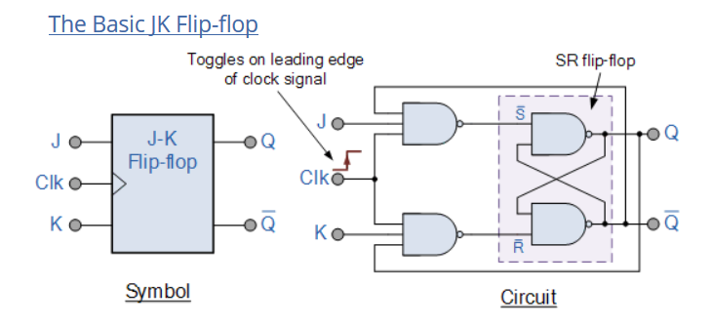
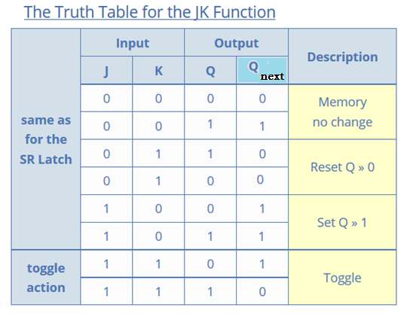

Slide 16
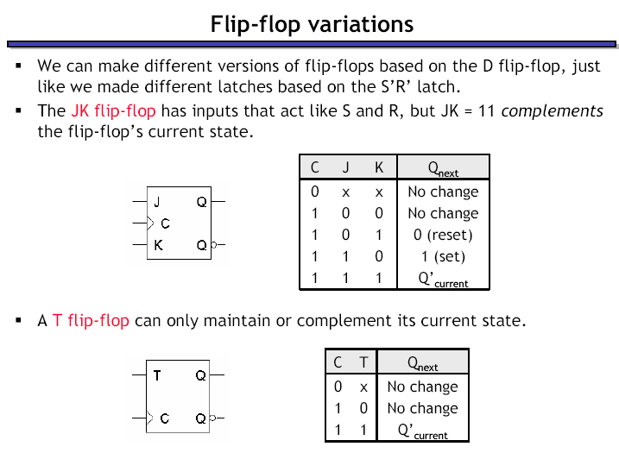

Slide 17
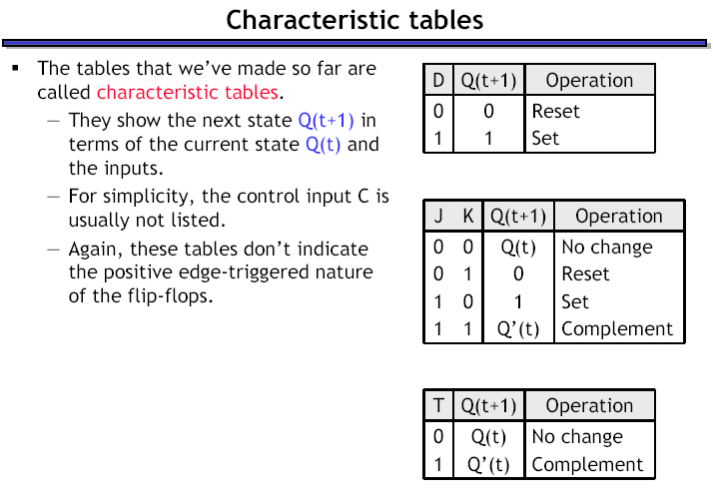

Slide 18
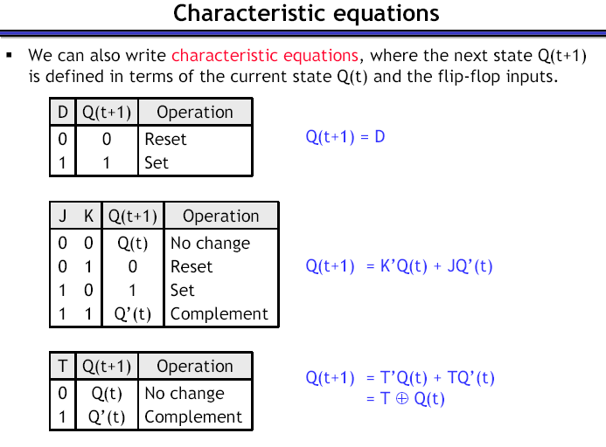

Slide 19
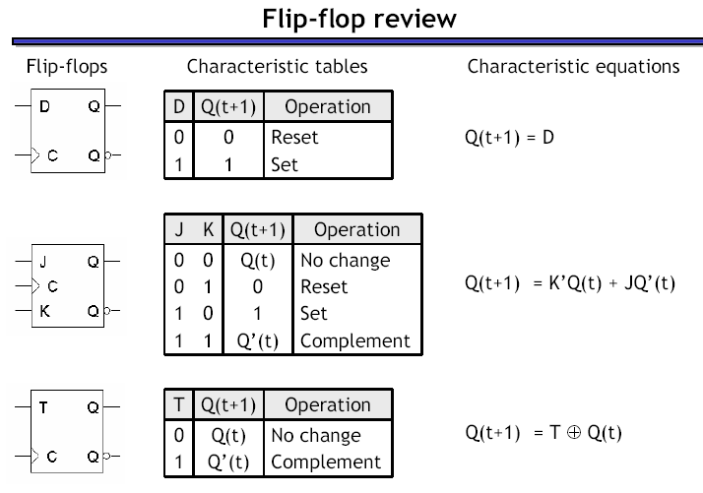

Slide 20
Regisrers

Slide 23
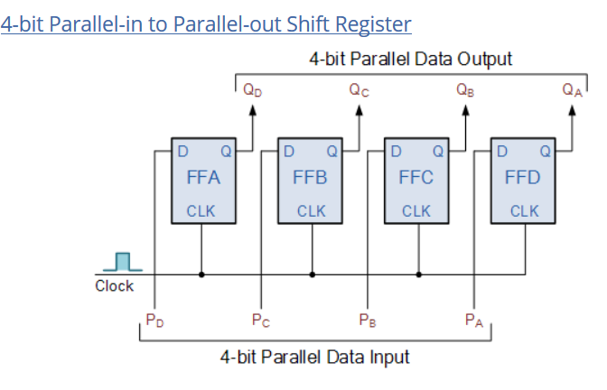

Slide 26
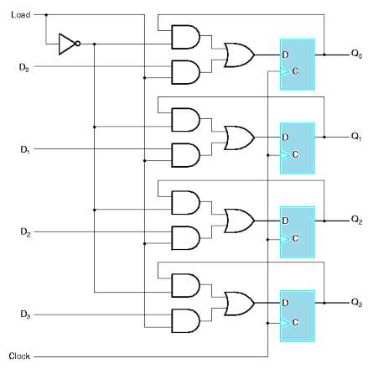

Slide 27
MUX 2 - 1
MUX 2 - 1

Slide 28
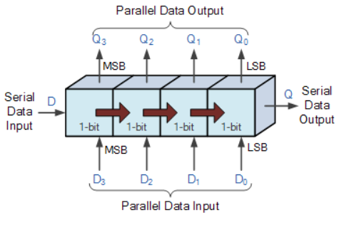

Slide 29
Serial-in to Serial-out (SISO) Shift Register

Slide 30
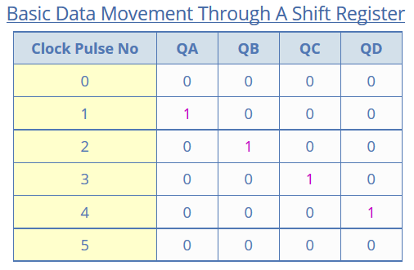
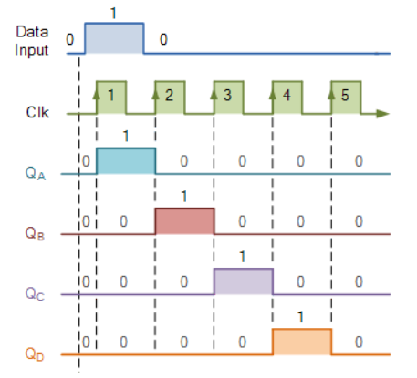

Slide 31
Serial
Parallel
MUX 2 - 1
MUX 2 - 1

Slide 33
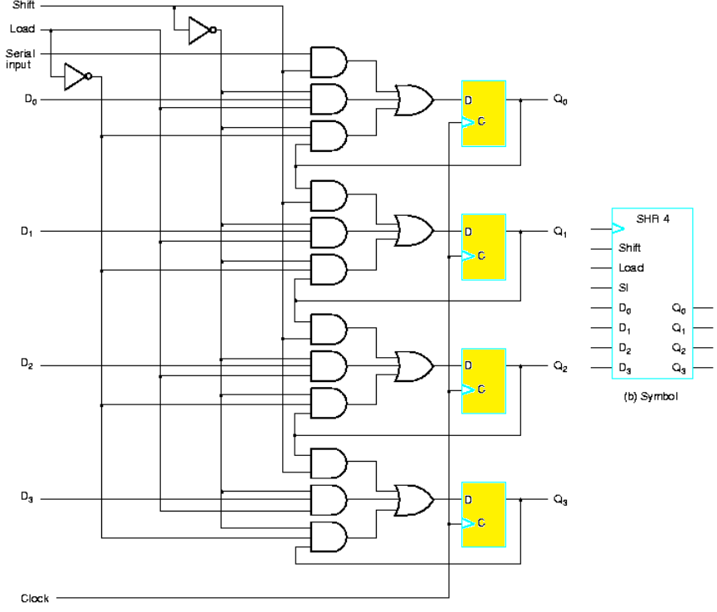

Slide 34
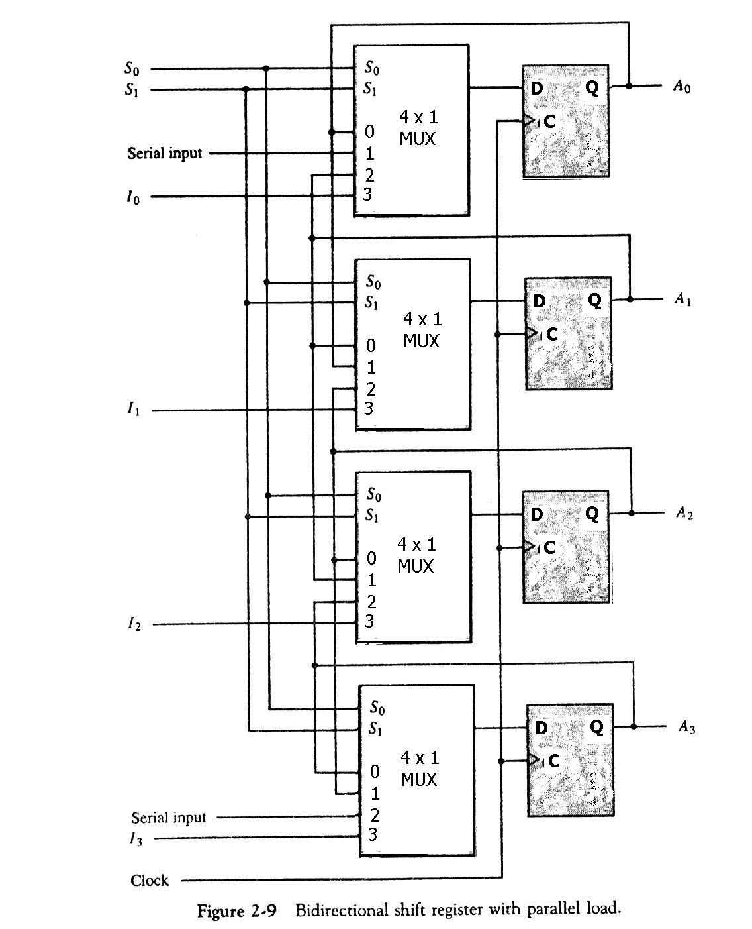
 |  |  | S0 | S1
 | No change |  | 0 | 0
Shift left (down |  |  | 1 | 0
 | Shift right (up) |  | 0 | 1
 | Parallel load |  | 1 | 1

Slide 35
Other types of shift registers
Logical shifts – Standard shifts like we just saw. In the absence of a SI input, 0 occupies the vacant position.
Left: 0110 -> 1100
Right: 0110 -> 0011
Circular shifts (also called ring counters or rotates) – The shifted out bit wraps around to the vacant position.
Left: 1001 -> 0011
Right: 1001 -> 1100
Switch-tail ring counter (aka Johnson counter) – Similar to the ring counter, but the serial input is the complement of the serial output.
Left: 1001 -> 0010
Right: 1001 -> 0100
Arithmetical shifts – Left shifting is the same as a logical shift. Right shifting however maintains the MSB.
Left: 0110 -> 1100
Right: 0110 -> 0011; 1011 -> 1101

Slide 36
Example
Consider a 4-bit register with the following inputs
parallel data inputs ABCD = 0011
left serial input LSI = 1 (This is the serial input for a left shift.)
right serial input RSI = 0 (This is the serial input for a right shift.)
The three control inputs S₂, S₁, S₀ operate as shown in the table to the right.
Let the initial register content be Q_{A}Q_{B}Q_{C}Q_{D} = 0101
S2 | S1 | S0 | Operation
0 | 0 | 0 | left shift
0 | 0 | 1 | circular left shift
0 | 1 | 0 | right shift
0 | 1 | 1 | circular right shift
1 | 0 | 0 | no change
1 | 0 | 1 | parallel load
1 | 1 | 0 | complement each bit
1 | 1 | 1 | set to 1111

Slide 37
Example
S2 | S1 | S0 | Operation
0 | 0 | 0 | left shift
0 | 0 | 1 | circular left shift
0 | 1 | 0 | right shift
0 | 1 | 1 | circular right shift
1 | 0 | 0 | no change
1 | 0 | 1 | parallel load
1 | 1 | 0 | complement each bit
1 | 1 | 1 | set to 1111
Other Information
Parallel Load |  |  | ABCD = 0011
LS1 |  |  | 1
RSI |  |  | 0
S2 | S1 | S0 | Q_{A} | Q_{B} | Q_{C} | Q_{D}
 |  |  | 0 | 1 | 0 | 1
0 | 0 | 0
0 | 0 | 1
0 | 1 | 0
1 | 0 | 0
0 | 1 | 1
1 | 0 | 1
1 | 1 | 1
0 | 0 | 0
1 | 1 | 0

Slide 38
Example
S2 | S1 | S0 | Operation
0 | 0 | 0 | left shift
0 | 0 | 1 | circular left shift
0 | 1 | 0 | right shift
0 | 1 | 1 | circular right shift
1 | 0 | 0 | no change
1 | 0 | 1 | parallel load
1 | 1 | 0 | complement each bit
1 | 1 | 1 | set to 1111
Other Information
Parallel Load |  |  | ABCD = 0011
LS1 |  |  | 1
RSI |  |  | 0
S2 | S1 | S0 | Q_{A} | Q_{B} | Q_{C} | Q_{D}
 |  |  | 0 | 1 | 0 | 1
0 | 0 | 0
0 | 0 | 1
0 | 1 | 0
1 | 0 | 0
0 | 1 | 1
1 | 0 | 1
1 | 1 | 1
0 | 0 | 0
1 | 1 | 0

Slide 39
Example
S2 | S1 | S0 | Operation
0 | 0 | 0 | left shift
0 | 0 | 1 | circular left shift
0 | 1 | 0 | right shift
0 | 1 | 1 | circular right shift
1 | 0 | 0 | no change
1 | 0 | 1 | parallel load
1 | 1 | 0 | complement each bit
1 | 1 | 1 | set to 1111
Other Information
Parallel Load |  |  | ABCD = 0011
LS1 |  |  | 1
RSI |  |  | 0
S2 | S1 | S0 | Q_{A} | Q_{B} | Q_{C} | Q_{D}
 |  |  | 0 | 1 | 0 | 1
0 | 0 | 0 | 1 | 0 | 1 | 1
0 | 0 | 1
0 | 1 | 0
1 | 0 | 0
0 | 1 | 1
1 | 0 | 1
1 | 1 | 1
0 | 0 | 0
1 | 1 | 0

Slide 40
Example
S2 | S1 | S0 | Operation
0 | 0 | 0 | left shift
0 | 0 | 1 | circular left shift
0 | 1 | 0 | right shift
0 | 1 | 1 | circular right shift
1 | 0 | 0 | no change
1 | 0 | 1 | parallel load
1 | 1 | 0 | complement each bit
1 | 1 | 1 | set to 1111
Other Information
Parallel Load |  |  | ABCD = 0011
LS1 |  |  | 1
RSI |  |  | 0
S2 | S1 | S0 | Q_{A} | Q_{B} | Q_{C} | Q_{D}
 |  |  | 0 | 1 | 0 | 1
0 | 0 | 0 | 1 | 0 | 1 | 1
0 | 0 | 1 | 0 | 1 | 1 | 1
0 | 1 | 0
1 | 0 | 0
0 | 1 | 1
1 | 0 | 1
1 | 1 | 1
0 | 0 | 0
1 | 1 | 0

Slide 41
Example
S2 | S1 | S0 | Operation
0 | 0 | 0 | left shift
0 | 0 | 1 | circular left shift
0 | 1 | 0 | right shift
0 | 1 | 1 | circular right shift
1 | 0 | 0 | no change
1 | 0 | 1 | parallel load
1 | 1 | 0 | complement each bit
1 | 1 | 1 | set to 1111
Other Information
Parallel Load |  |  | ABCD = 0011
LS1 |  |  | 1
RSI |  |  | 0
S2 | S1 | S0 | Q_{A} | Q_{B} | Q_{C} | Q_{D}
 |  |  | 0 | 1 | 0 | 1
0 | 0 | 0 | 1 | 0 | 1 | 1
0 | 0 | 1 | 0 | 1 | 1 | 1
0 | 1 | 0 | 0 | 0 | 1 | 1
1 | 0 | 0
0 | 1 | 1
1 | 0 | 1
1 | 1 | 1
0 | 0 | 0
1 | 1 | 0

Slide 42
Example
S2 | S1 | S0 | Operation
0 | 0 | 0 | left shift
0 | 0 | 1 | circular left shift
0 | 1 | 0 | right shift
0 | 1 | 1 | circular right shift
1 | 0 | 0 | no change
1 | 0 | 1 | parallel load
1 | 1 | 0 | complement each bit
1 | 1 | 1 | set to 1111
Other Information
Parallel Load |  |  | ABCD = 0011
LS1 |  |  | 1
RSI |  |  | 0
S2 | S1 | S0 | Q_{A} | Q_{B} | Q_{C} | Q_{D}
 |  |  | 0 | 1 | 0 | 1
0 | 0 | 0 | 1 | 0 | 1 | 1
0 | 0 | 1 | 0 | 1 | 1 | 1
0 | 1 | 0 | 0 | 0 | 1 | 1
1 | 0 | 0 | 0 | 0 | 1 | 1
0 | 1 | 1
1 | 0 | 1
1 | 1 | 1
0 | 0 | 0
1 | 1 | 0

Slide 43
Example
S2 | S1 | S0 | Operation
0 | 0 | 0 | left shift
0 | 0 | 1 | circular left shift
0 | 1 | 0 | right shift
0 | 1 | 1 | circular right shift
1 | 0 | 0 | no change
1 | 0 | 1 | parallel load
1 | 1 | 0 | complement each bit
1 | 1 | 1 | set to 1111
Other Information
Parallel Load |  |  | ABCD = 0011
LS1 |  |  | 1
RSI |  |  | 0
S2 | S1 | S0 | Q_{A} | Q_{B} | Q_{C} | Q_{D}
 |  |  | 0 | 1 | 0 | 1
0 | 0 | 0 | 1 | 0 | 1 | 1
0 | 0 | 1 | 0 | 1 | 1 | 1
0 | 1 | 0 | 0 | 0 | 1 | 1
1 | 0 | 0 | 0 | 0 | 1 | 1
0 | 1 | 1 | 1 | 0 | 0 | 1
1 | 0 | 1
1 | 1 | 1
0 | 0 | 0
1 | 1 | 0

Slide 44
Example
S2 | S1 | S0 | Operation
0 | 0 | 0 | left shift
0 | 0 | 1 | circular left shift
0 | 1 | 0 | right shift
0 | 1 | 1 | circular right shift
1 | 0 | 0 | no change
1 | 0 | 1 | parallel load
1 | 1 | 0 | complement each bit
1 | 1 | 1 | set to 1111
Other Information
Parallel Load |  |  | ABCD = 0011
LS1 |  |  | 1
RSI |  |  | 0
S2 | S1 | S0 | Q_{A} | Q_{B} | Q_{C} | Q_{D}
 |  |  | 0 | 1 | 0 | 1
0 | 0 | 0 | 1 | 0 | 1 | 1
0 | 0 | 1 | 0 | 1 | 1 | 1
0 | 1 | 0 | 0 | 0 | 1 | 1
1 | 0 | 0 | 0 | 0 | 1 | 1
0 | 1 | 1 | 1 | 0 | 0 | 1
1 | 0 | 1 | 0 | 0 | 1 | 1
1 | 1 | 1
0 | 0 | 0
1 | 1 | 0

Slide 45
Example
S2 | S1 | S0 | Operation
0 | 0 | 0 | left shift
0 | 0 | 1 | circular left shift
0 | 1 | 0 | right shift
0 | 1 | 1 | circular right shift
1 | 0 | 0 | no change
1 | 0 | 1 | parallel load
1 | 1 | 0 | complement each bit
1 | 1 | 1 | set to 1111
Other Information
Parallel Load |  |  | ABCD = 0011
LS1 |  |  | 1
RSI |  |  | 0
S2 | S1 | S0 | Q_{A} | Q_{B} | Q_{C} | Q_{D}
 |  |  | 0 | 1 | 0 | 1
0 | 0 | 0 | 1 | 0 | 1 | 1
0 | 0 | 1 | 0 | 1 | 1 | 1
0 | 1 | 0 | 0 | 0 | 1 | 1
1 | 0 | 0 | 0 | 0 | 1 | 1
0 | 1 | 1 | 1 | 0 | 0 | 1
1 | 0 | 1 | 0 | 0 | 1 | 1
1 | 1 | 1 | 1 | 1 | 1 | 1
0 | 0 | 0
1 | 1 | 0

Slide 46
Example
S2 | S1 | S0 | Operation
0 | 0 | 0 | left shift
0 | 0 | 1 | circular left shift
0 | 1 | 0 | right shift
0 | 1 | 1 | circular right shift
1 | 0 | 0 | no change
1 | 0 | 1 | parallel load
1 | 1 | 0 | complement each bit
1 | 1 | 1 | set to 1111
Other Information
Parallel Load |  |  | ABCD = 0011
LS1 |  |  | 1
RSI |  |  | 0
S2 | S1 | S0 | Q_{A} | Q_{B} | Q_{C} | Q_{D}
 |  |  | 0 | 1 | 0 | 1
0 | 0 | 0 | 1 | 0 | 1 | 1
0 | 0 | 1 | 0 | 1 | 1 | 1
0 | 1 | 0 | 0 | 0 | 1 | 1
1 | 0 | 0 | 0 | 0 | 1 | 1
0 | 1 | 1 | 1 | 0 | 0 | 1
1 | 0 | 1 | 0 | 0 | 1 | 1
1 | 1 | 1 | 1 | 1 | 1 | 1
0 | 0 | 0 | 1 | 1 | 1 | 1
1 | 1 | 0

Slide 47
Example
S2 | S1 | S0 | Operation
0 | 0 | 0 | left shift
0 | 0 | 1 | circular left shift
0 | 1 | 0 | right shift
0 | 1 | 1 | circular right shift
1 | 0 | 0 | no change
1 | 0 | 1 | parallel load
1 | 1 | 0 | complement each bit
1 | 1 | 1 | set to 1111
Other Information
Parallel Load |  |  | ABCD = 0011
LS1 |  |  | 1
RSI |  |  | 0
S2 | S1 | S0 | Q_{A} | Q_{B} | Q_{C} | Q_{D}
 |  |  | 0 | 1 | 0 | 1
0 | 0 | 0 | 1 | 0 | 1 | 1
0 | 0 | 1 | 0 | 1 | 1 | 1
0 | 1 | 0 | 0 | 0 | 1 | 1
1 | 0 | 0 | 0 | 0 | 1 | 1
0 | 1 | 1 | 1 | 0 | 0 | 1
1 | 0 | 1 | 0 | 0 | 1 | 1
1 | 1 | 1 | 1 | 1 | 1 | 1
0 | 0 | 0 | 1 | 1 | 1 | 1
1 | 1 | 0 | 0 | 0 | 0 | 0

